Slide 1

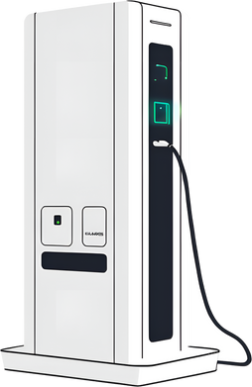


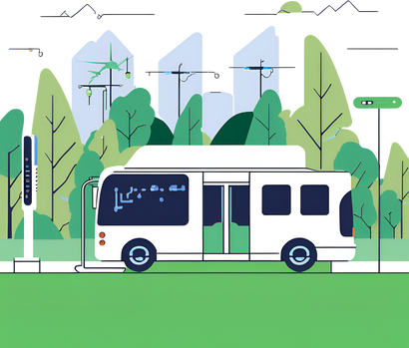
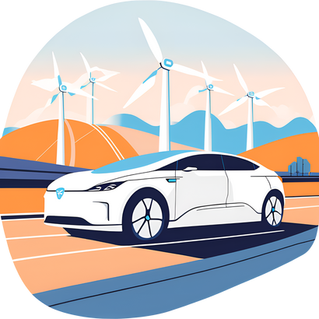
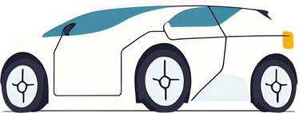
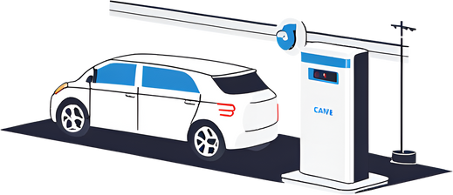

Electric Vehicle Analysis
#resume_project_challange
Created By
Ritik Sharma
Notes:
Hello everyone, I’m Ritik Sharma, and reason i'm here is that i'm presenting my analysis presentation of Electric Vehicle data as part of the Codebasics Resume Project Challenge.
This is my first video presentation so i'm excited and nervous at the same time.
In this presentation, I’ll walk you through my findings, focusing on key areas such as the availability of charging infrastructure, sales trends, and how these factors influence EV market penetration across different states. Let’s get started!

Slide 2


Project Overview
Objectives
AtliQ Motors is an automotive giant from the USA specializing in electric vehicles (EV).
In the last 5 years, their market share rose to 25% in electric and hybrid vehicles segment in North America.
As a part of their expansion plans, they wanted to launch their bestselling models in India where their market share is less than 2%.
Task
AtliQ Motors
Bruce Haryali, the chief of AtliQ Motors India wanted to do a detailed market study of existing EV/Hybrid market in India before proceeding further.
Notes:
they provided dataset which contains all the information about ev sales in fiscal year 2022 2023 and 2024.
As a challange i have to answer some of the questions. and the questions is of two types one is primary research question which are basically finding trends and insights from the data and the another is secondary research question.

Slide 3

Primary Research Questions:
Notes:
So, at first let's have a look at primary research questions

Slide 4
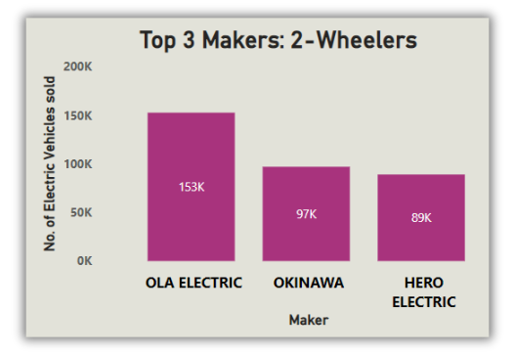
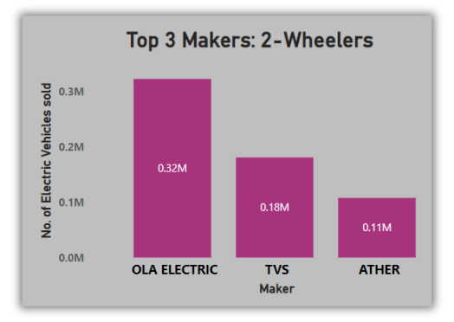
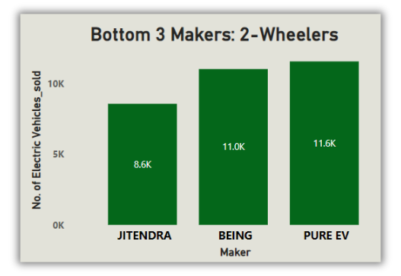
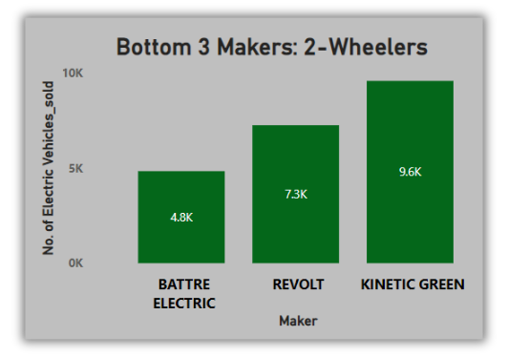
Q1)List the top 3 and bottom 3 makers for the fiscal years 2023 and 2024 in terms of the number of 2-wheelers sold.
2023
2024
Insights:
Ola's sales witnessed an impressive growth of over 109%.
All the three bottom makers in 2024 are changes as compared to 2023.
TVS & Ather shows impressive improvement.
Notes:
if we look at the graphs for top 3 makers ola electric is at top in 2023 with 153k sales and it is also leading in 2024 with 0.32M which is 320k. So, dusring the time period ola electric doubled their sale which is a good sign.
In bottom 3 there is a change in 2024 as compared to 2023 which means you have to evolve to grow in the market.

Slide 5
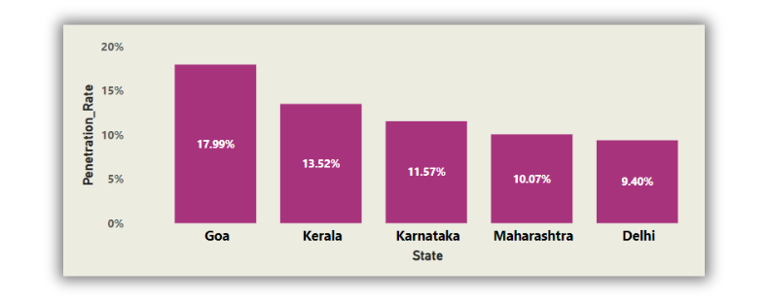
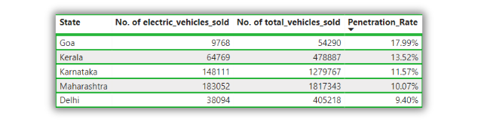

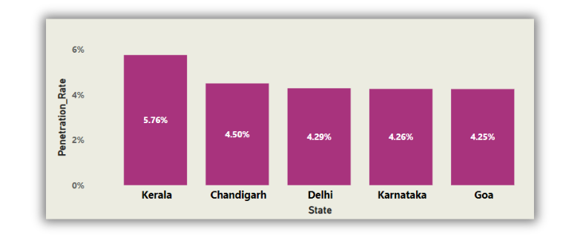
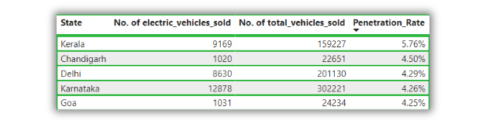
Q2) Identify the top 5 states with the highest penetration rate in 2-wheeler and 4-wheeler EV sales in FY 2024.
2-Wheelers
4-Wheelers
Insight:
Kerala leads in 4-wheeler EV penetration at 5.76% and ranks 2nd in 2-wheelers with 13.52%, highlighting its strong focus on electric mobility.
4 out of 5 states are the same in both categories.
Kerala will be a state to lookout for in the future with Delhi.

Slide 6
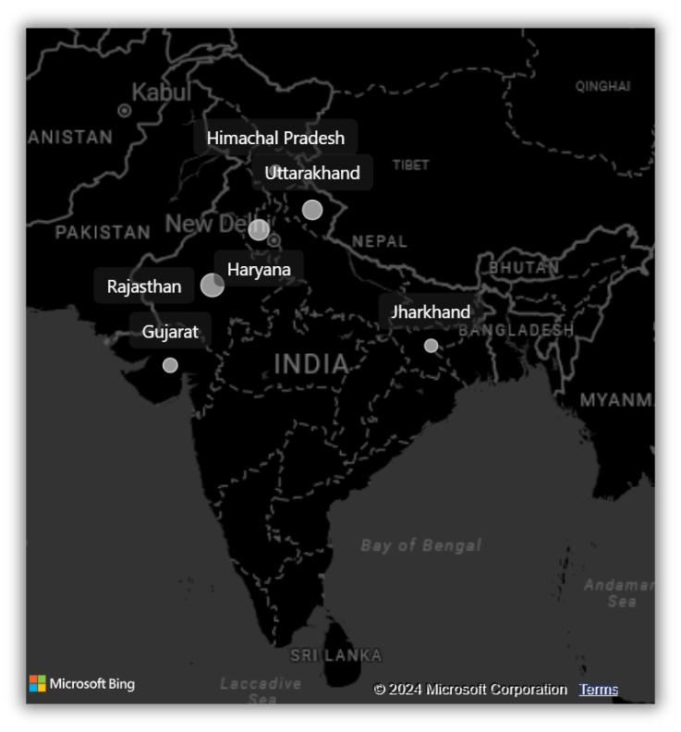
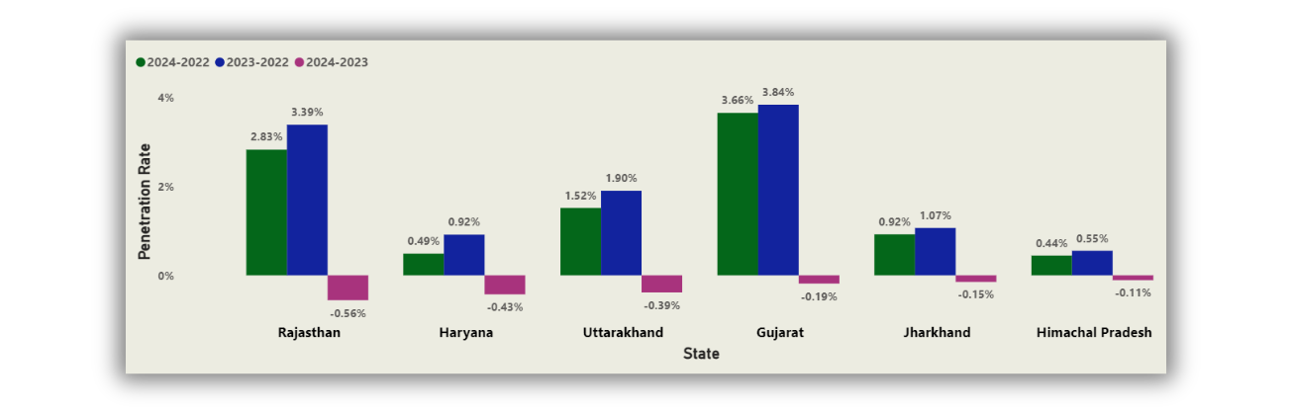
Q3) List the states with negative penetration (decline) in EV sales from 2022 to 2024?
Notes:
The states with the negative penetration rate are
So, if we look at the chart we will notice that penetration is positive if compare pentration rate of 2024 to 2023 or 2023 to 2022 but there is change in the result whwn we compare penetration rate of 2024 to 2023.

Slide 7
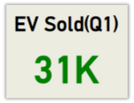
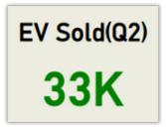
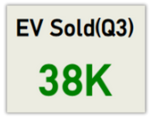
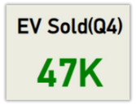
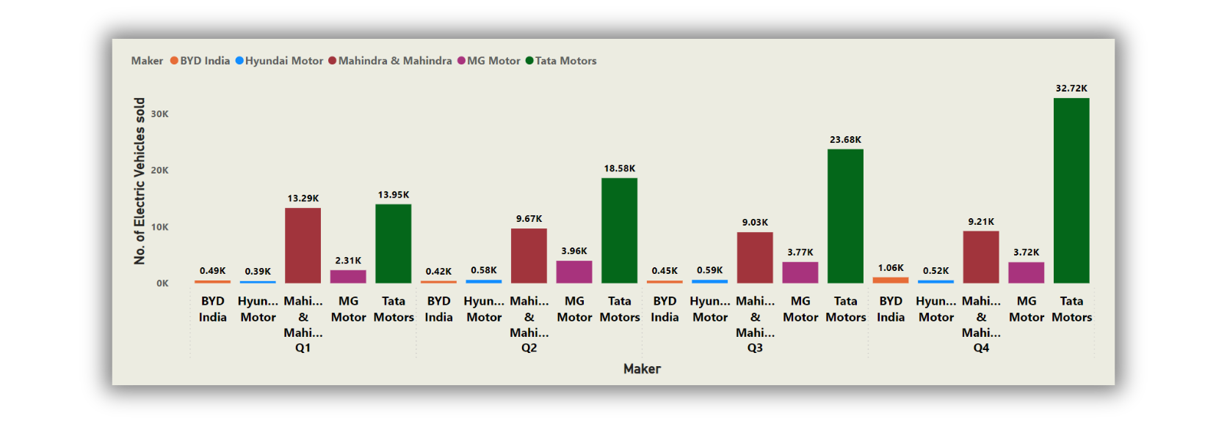
Q4)What are the quarterly trends based on sales volume for the top 5 EV makers (4-wheelers) from 2022 to 2024?
Notes:
Tata motors is leading the way with highest sales in all four quarters which means it is the giant of Indian EV market.
and we look sales increases as we move further in quarters.

Slide 8
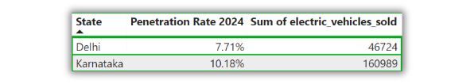
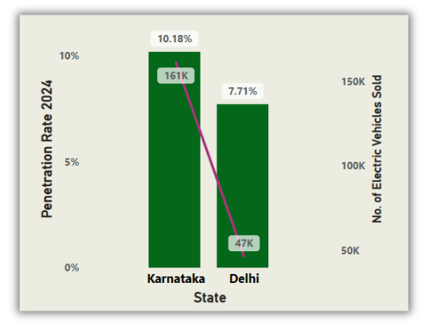
Q5) How do the EV sales and penetration rates in Delhi compare to Karnataka for 2024?
Insight:
Karnataka has a better penetration rate as compared to Delhi in fiscal year 2024.

Slide 9
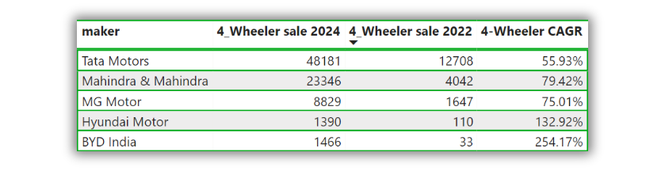
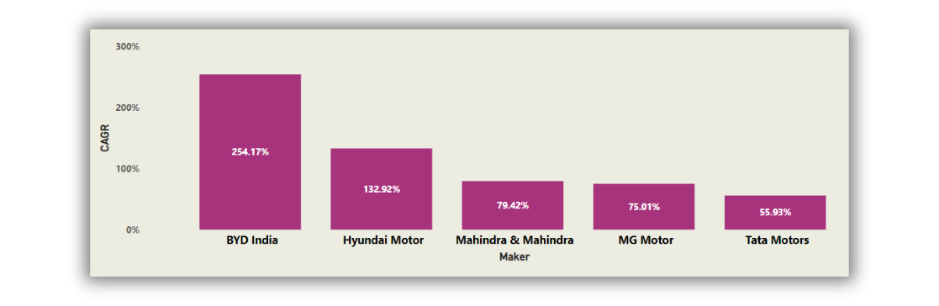
Q6)List down the compounded annual growth rate (CAGR) in 4-wheeler units for the top 5 makers from 2022 to 2024.
Insights:
BYD India tops the list with 254.17% CAGR.

Slide 10
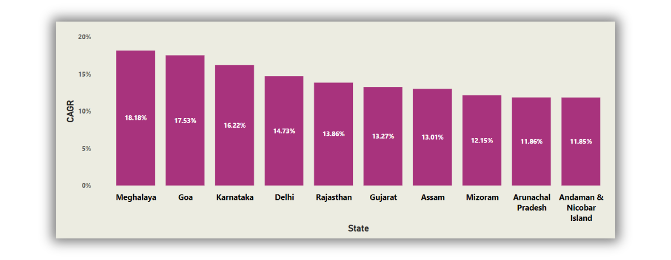
Q7) List down the top 10 states that had the highest compounded annual growth rate (CAGR) from 2022 to 2024 in total vehicles sold.
Insights:
Meghalaya has the CAGR of 18.18% which is highest.

Slide 11
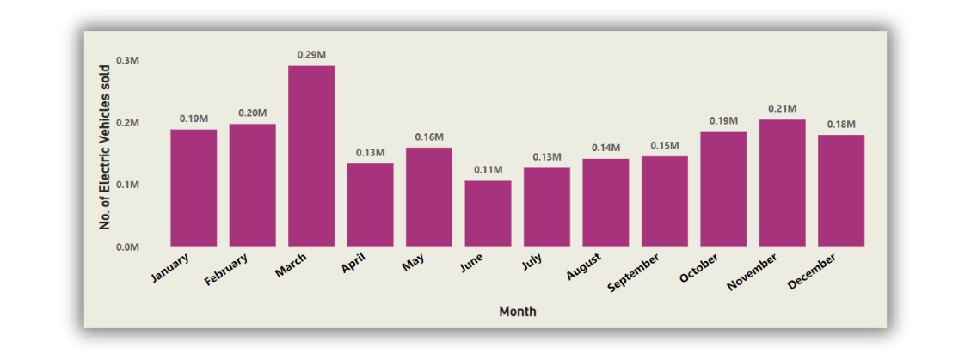
Q8) What are the peak and low season months for EV sales based on the data from 2022 to 2024?
Insights:
The First 3 months, which is Q4, have the highest number of EV sales.

Slide 12
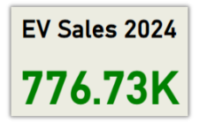
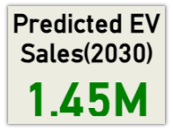
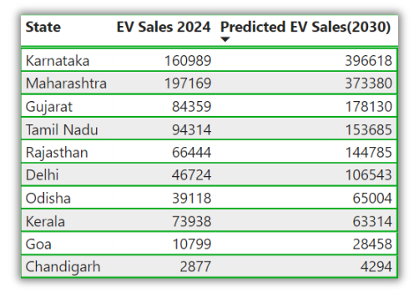
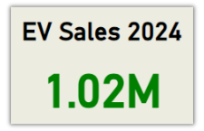
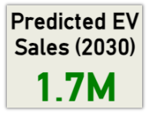
Q9) What is the projected number of EV sales (including 2-wheelers and 4 wheelers) for the top 10 states by penetration rate in 2030, based on the compounded annual growth rate (CAGR) from previous years?
Top 10 States
All States

Slide 13
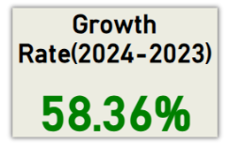
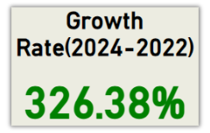
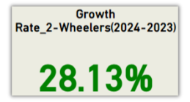
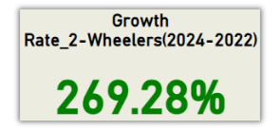
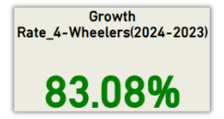
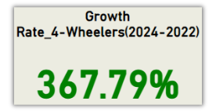
Q10) Estimate the revenue growth rate of 4-wheeler and 2-wheelers EVs in India for 2022 vs 2024 and 2023 vs 2024, assuming an average unit price.
2-Wheelers:85,000
4-Wheelers:15,00,000
Overall
2-Wheelers
4-Wheelers

Slide 14
Secondary Research Questions:
Notes:
Now lets have a look at the secondary research questions.

Slide 15

Q1) What are the primary reasons for customers choosing 4-wheeler EVs in 2023 and 2024 (cost savings, environmental concerns, government incentives)?
Cost Savings:
Lower operating costs and maintenance.
Long-term savings with declining battery prices.
Significant fuel cost reduction.
Government Incentives:
Subsidies, tax credits, and policy support.
Access to zero-emission zones.
Environmental Concerns:
Zero emissions for a reduced carbon footprint.
Appeal to environmentally conscious consumers.

Slide 16

Q2) How do government incentives and subsidies impact the adoption rates of 2-wheelers and 4-wheelers? Which states in India provided most subsidies?
Lower Costs
Faster Adoption
Infrastructure Development
Technological Advancements
Policy Stability
The Delhi is the best state to look out for, as it offers the most substantial subsidies for EVs, including high financial incentives, exemption from road tax, and registration fee waivers. Additionally, Delhi provides scrappage incentives, making it a leading state in promoting EV adoption.
Leading Indian States in EV Subsidies:
Delhi: High subsidies, exemption from road tax.
Maharashtra: Comprehensive policy, early adopter bonuses.
Gujarat: Direct subsidies, focus on affordability.
Tamil Nadu: Manufacturing incentives, comprehensive support.
Karnataka: Pioneering policies, charging infrastructure incentives.

Slide 17
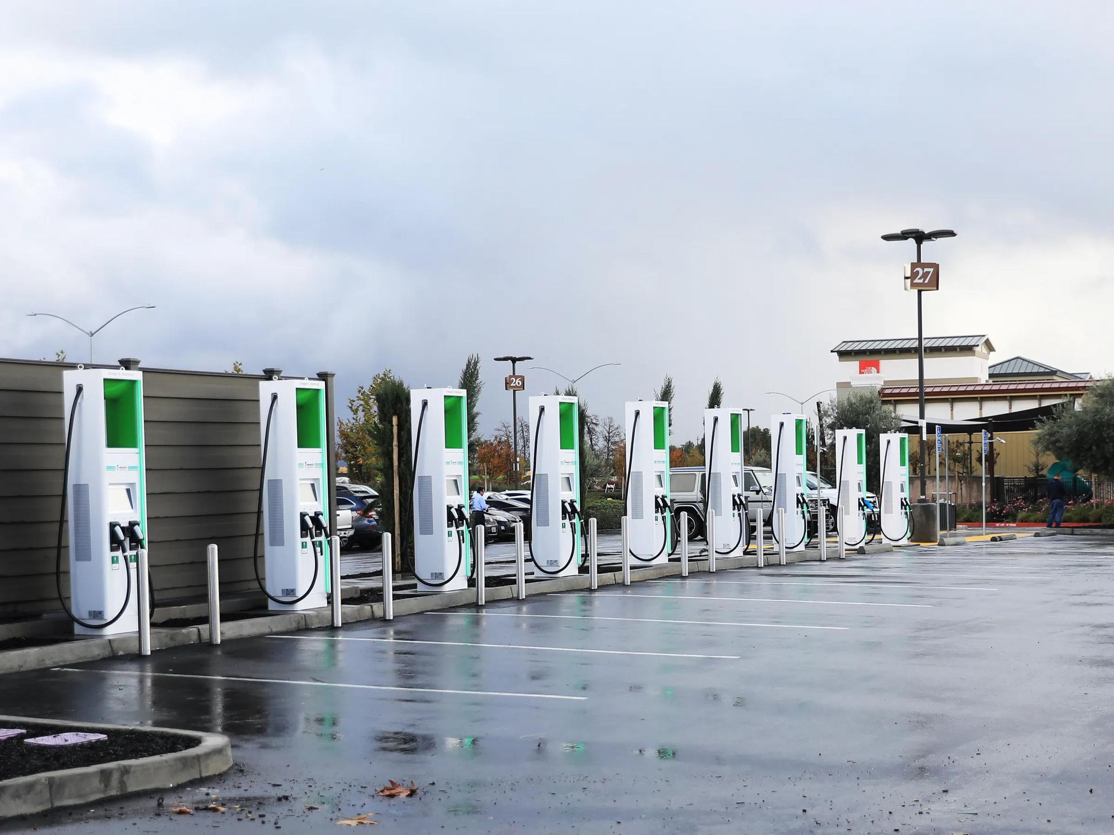
Q3)How does the availability of charging stations infrastructure correlate with the EV sales and penetration rates in the top 5 states?
Drives EV Sales: Higher sales in states with dense charging networks & encourages long-distance travel.
Increases Penetration Rates: Strong infrastructure leads to higher market penetration.
Boosts Consumer Confidence: Reduces range anxiety.
Delhi: High EV adoption due to extensive charging network.
Maharashtra: Expanding infrastructure correlates with rising sales.
Gujarat: Government support drives high penetration.
Tamil Nadu: Focus on manufacturing and infrastructure boosts adoption.
Karnataka: Expanding infrastructure supports tech-savvy population.
States investing in charging infrastructure see higher EV sales and penetration, particularly in urbanized areas with supportive policies.

Slide 18
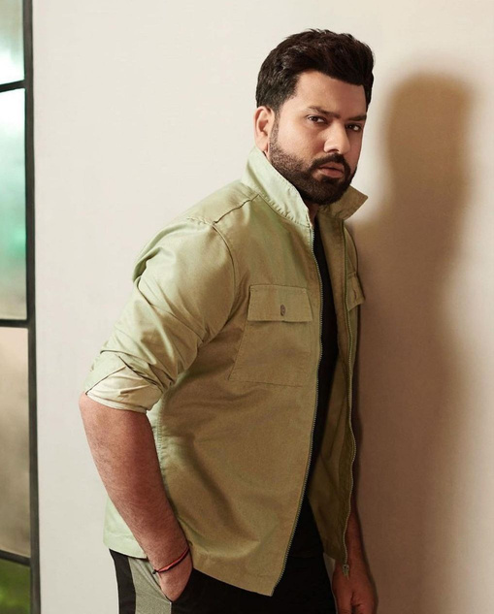
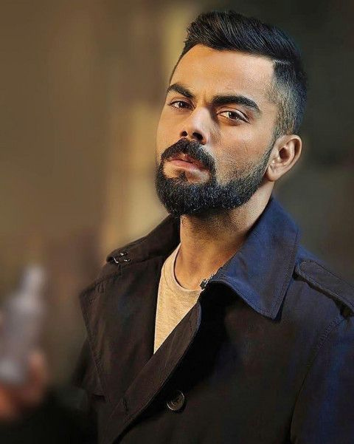



Q4) Who should be the brand ambassador if AtliQ Motors launches their EV/Hybrid vehicles in India and why?
Consider choosing either Rohit Sharma or Virat Kohli as the brand ambassador for AtliQ Motors, leveraging their popularity, trustworthiness, and influence to effectively promote your EV/Hybrid vehicles.
Why Choose a Cricket Personality?
Mass Appeal: Cricket is the most popular sport in India, with players commanding immense attention and influence nationwide.
Trust and Credibility: Cricketers are trusted figures, admired for their discipline, performance, and integrity, which enhances the brand’s reliability.
Emotional Connection: Cricket evokes strong emotions in India, and associating with a cricket personality can build a deep emotional bond with consumers.
Nationwide Reach: Cricketers appeal to diverse audiences across both urban and rural areas, ensuring broad market coverage.

Slide 19
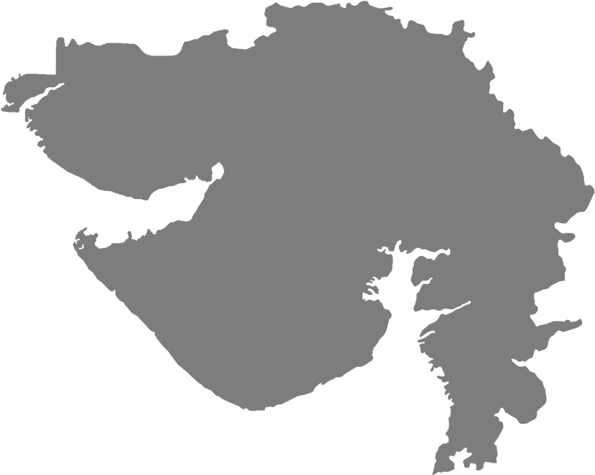
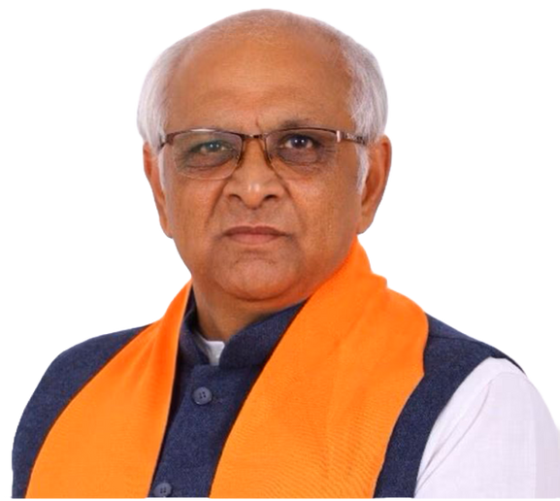
Q5)Which state of India is ideal to start the manufacturing unit? (Based on subsidies provided, ease of doing business, stability in governance etc.)
Gujarat is the top choice
Strong Incentives: Attractive subsidies, tax exemptions, and power tariff benefits.
Business-Friendly Environment: High ease of doing business, robust infrastructure.
Stable Governance: Consistent political stability and strategic access to domestic and international markets.
Bhupendra Patel
CM of Gujrat

Slide 20

Q5)Your top 3 recommendations for AtliQ Motors.
Strengthen Charging Infrastructure:
Partner with charging station operators and energy companies.
Incentivize home charging solutions for customers.
Leverage Government Incentives:
Maximize state and central subsidies and tax rebates.
Engage in policy advocacy for favourable EV policies.
Focus on Consumer Education & Brand Positioning:
Launch awareness campaigns on EV benefits and cost savings.
Build a robust after-sales service network to enhance customer satisfaction.
Application For Charging Stations Realtime Information
Develop a application for the Atliq Motors Charging Stations.
Provide real time update of the charging station like they are working or not.
Help owner to navigate to the nearest Charging Station.

Slide 21

USE EV
SAVE ENVIRONMENT
Notes:
At last i want to thank
Bhavel Patel and Hemanand to providing me and many more students like me out there this opportunity. I want to thank whole code basics team. and thank you all for watching till the very end.

